Slide 1
Bike Sharing Demand Analysis Project
NextHikes IT Solutions
Prepared by: Rahul E.R.

Slide 2
Project Overview
The Bike Sharing Demand Analysis Project aims to uncover patterns and key factors influencing bike rental demand.
Dataset Summary:
- 1,000 hourly records
- Variables include temperature, humidity, windspeed, weather situation, and registered users.
Objective: Identify trends to optimize resource allocation, marketing, and operational planning.

Slide 3
Key KPIs & Insights
- Average hourly rental count: ~450
- Peak demand during moderate temperatures (0.6–0.8 normalized range)
- Weekdays see higher permanent user activity; weekends show more temporary users
- Weather has a significant effect — demand drops sharply in poor conditions
- Optimal conditions: clear or slightly cloudy weather, moderate temperatures, and low windspeed

Slide 4
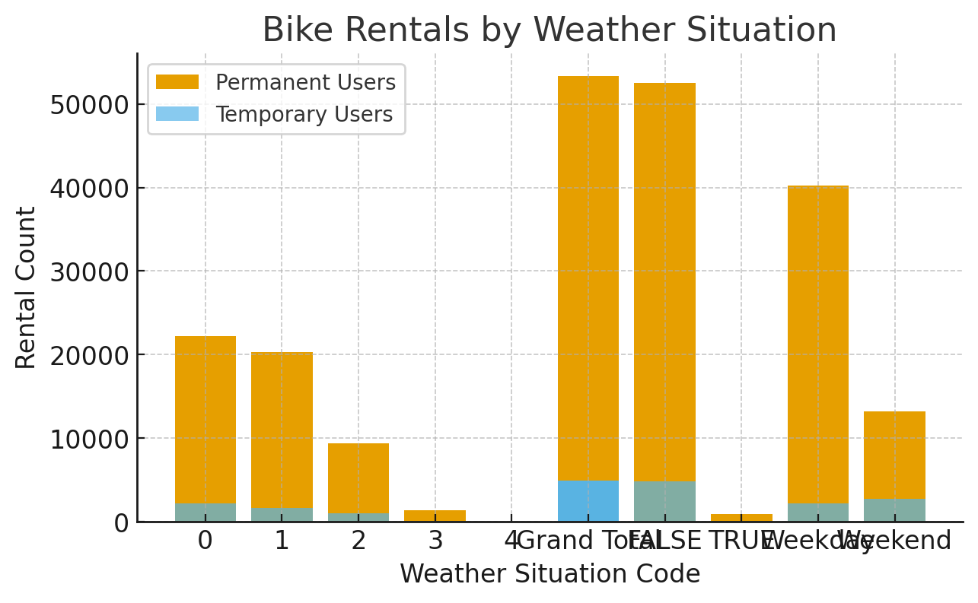
Bike Rentals by Weather Situation
Rental activity is highest under clear or partly cloudy conditions, while poor weather (rain/snow) causes a steep drop in demand.

Slide 5
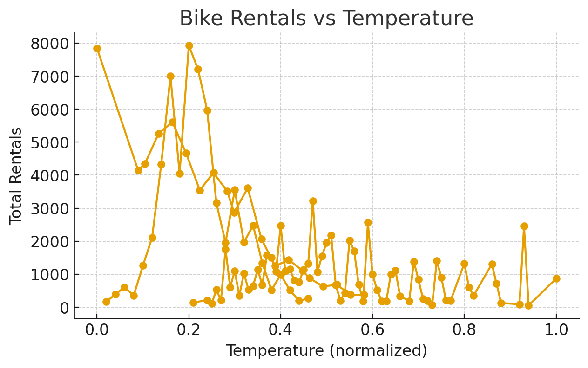
Bike Rentals vs Temperature
Rentals increase steadily with temperature until around 0.6 normalized level, beyond which extreme heat slightly reduces demand.

Slide 6
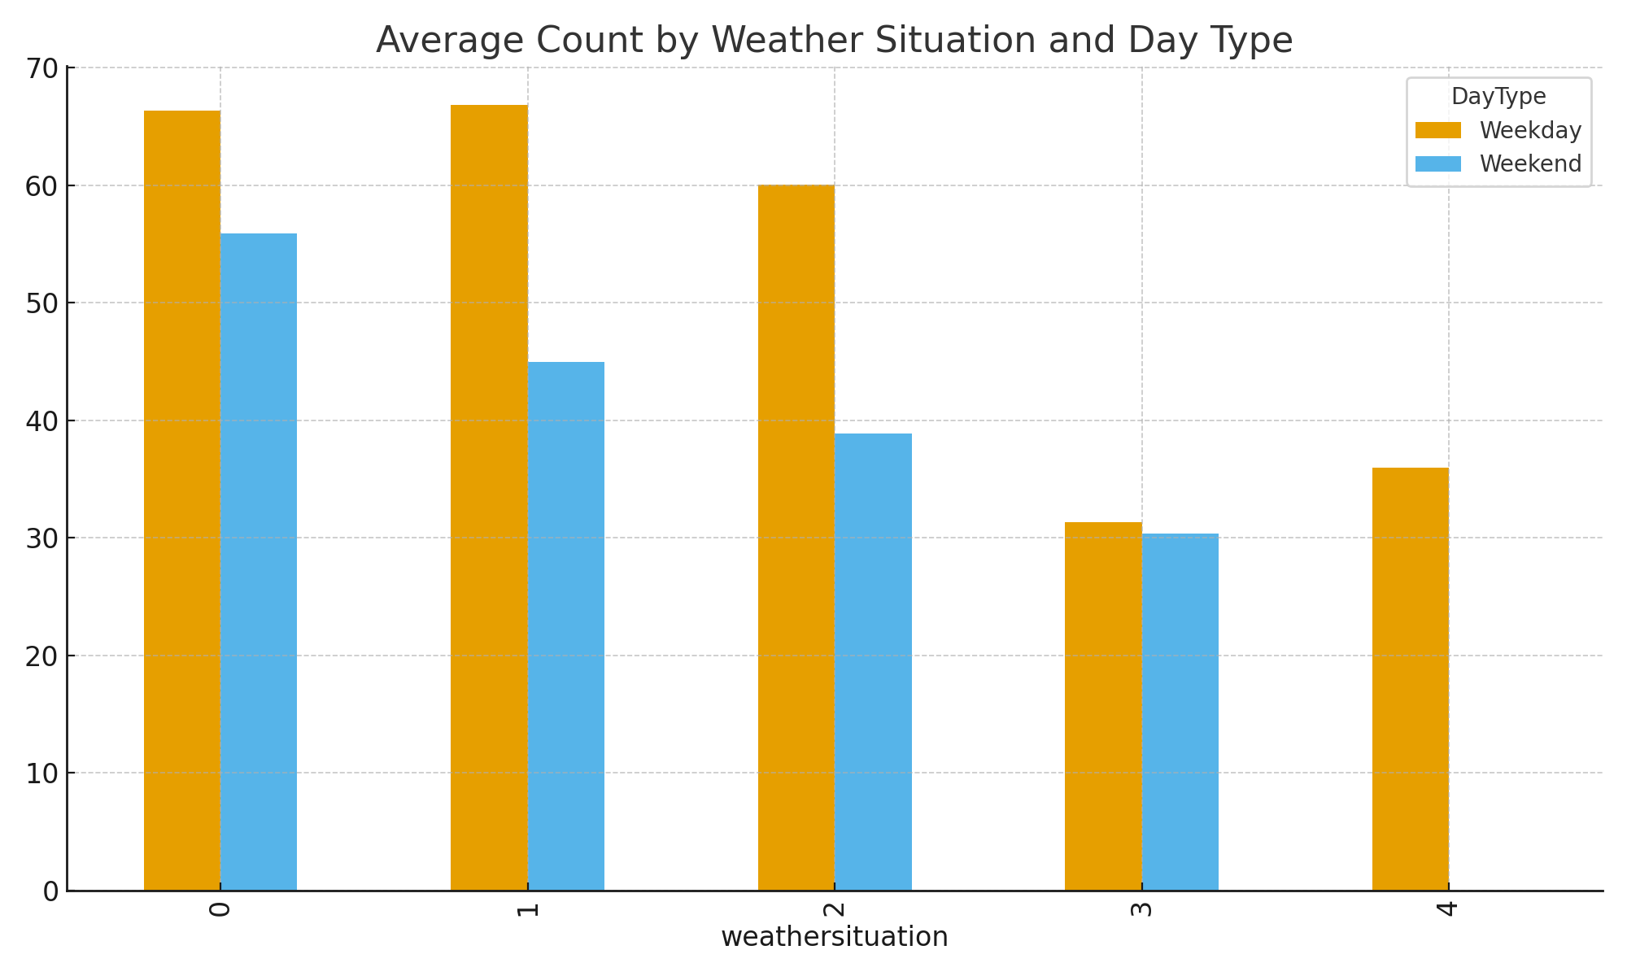
Weather vs Day Type
Figure Shows how bike usage varies across different weather situations and day types.

Slide 7
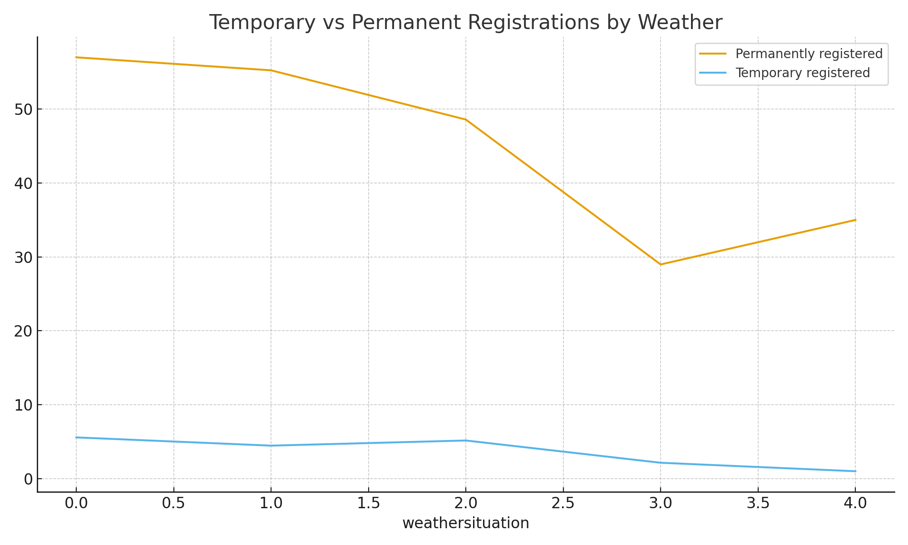
Registrations vs Weather
Figure Illustrates how temporary and permanent registrations fluctuate under different weather conditions.

Slide 8
Conclusions & Recommendations
1. Weather Sensitivity: Clear weather drives maximum demand promotional campaigns can align with favorable forecasts.
2. Temperature Range:Maintain high availability of bikes in moderate temperature conditions (0.5 - 0.8).
3. User Segmentation: Encourage temporary users during weekends via discounts or referral programs.
4. Operational Optimization:Adjust maintenance and staff scheduling around off-peak hours and adverse weather days.
Encouraging ridership through incentives during poor weather, maintaining bikes efficiently, and improving temporary user conversion rates can enhance utilization across all segments.

Slide 9
Summary
The Bike Sharing Demand Analysis Project identifies key factors driving bike rental usage.
Average hourly rentals ~450; demand peaks during moderate temperatures.
Clear or partly cloudy weather maximizes demand; poor weather sharply reduces it.
Permanent users dominate weekdays; casual users drive weekend demand.
Recommendations: - Align marketing with favorable weather.
Maintain high bike availability in optimal conditions (0.5–0.8 temp range).
Offer weekend promotions to attract temporary users.
Optimize operations around low-demand and bad-weather periods.

